Slide 1

Data Structures & Algorithms
Week-08

Slide 2
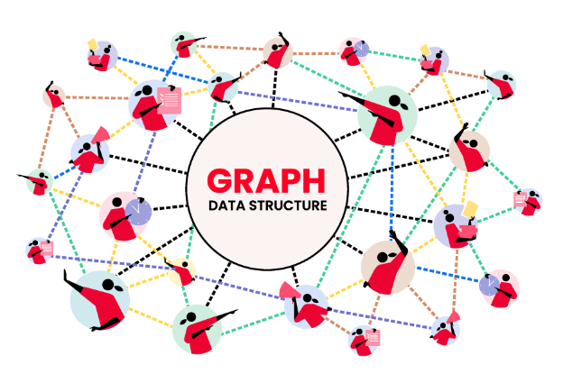
Week-08 Agenda
Graph Data Structures

Slide 3
Graphs
A graph is non-linear data structure.
It is a collection of nodes connected to each other by edges. Each node contains a data field.
EXAMPLE:
On Facebook, every profile is a node, including photos, videos, events, pages, and all other properties that have data.
And every connection acts as an edge, whether it’s between you and your Facebook friend or just a page you’ve liked.
Facebook and other social networks are just huge collections of nodes and edges.
Graph data structure solves many real-life problems. Most importantly they’re used to represent networks such as road networks in a city or circuit

Slide 4
Graphs
A graph consists of:
  A collection of nodes also known as vertices, in this case
  A collection of edges E connecting the vertices, (represented as ordered pair of vertices - 0, 1)

Slide 5
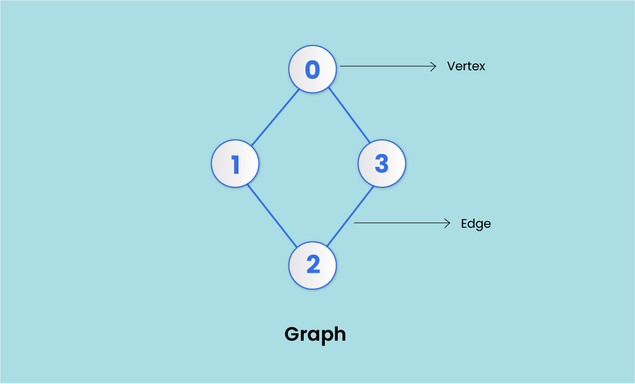
Graphs
V (Vertices) = {0, 1, 2, 3}
E (Edges) = {(0,1), (0,2), (0,3), (1,2)}
G (Graph) = {V, E}

Slide 6
Graph Terminology
Vertex - Each node of a graph is called a vertex. (plural - vertices). In the image above, the dots represented by 0, 1, 2, and 3 are vertices.
Edge - Edges in a graph are the lines that connect two vertices. In the image above- the line (0, 1) from 0 to 1 represents an edge, similarly (1, 2), and so on.
Edges can be represented in the form of two-dimensional arrays.

Slide 7
Graph Terminology
Adjacency - A vertex is adjacent to another vertex if there is an edge connecting them. In the image above, vertices 0 and 1 are adjacent, but vertices 1 and 3 are not adjacent as there’s no edge between them.
Paths - A series of edges that takes you from one vertex to another when they’re not adjacent to each other. In the above example: 1 and 3 are not adjacent. So, the sequence of edges [(1, 2), (2, 3)] will represent a path.

Slide 8
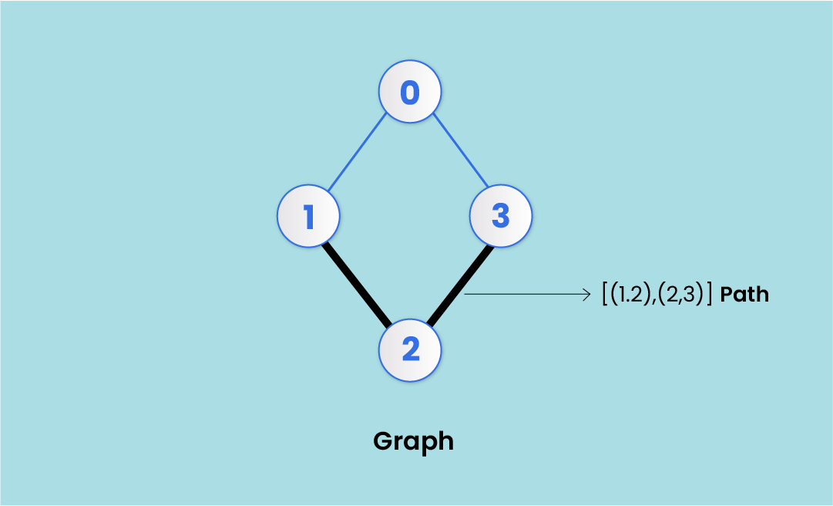
Graph Terminology

Slide 9
Basic Operations in a Graph
Add/Remove Vertex
This is the most basic operation in a graph. You have to simply add a vertex to the graph; not needing to connect it with some other vertex through an edge.
While removing a vertex, you have to delete all the edges to and from that particular vertex.

Slide 10
Basic Operations in a Graph
Add/Remove Edge
This operation adds or removes an edge between two vertices.
If all the edges originating from or ending at say vertex 1 is removed, 1 would become isolated.

Slide 11
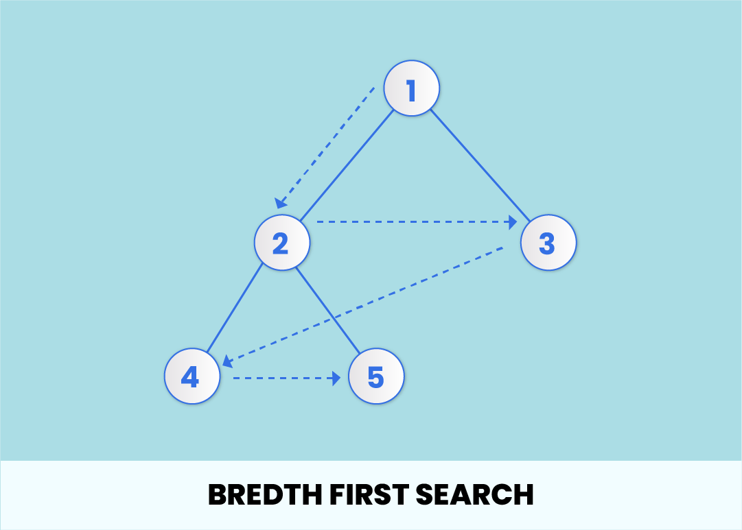
Basic Operations in a Graph

Slide 12
Basic Operations in a Graph
This search operation traverses all the nodes at a single level/hierarchy before moving on to the next level of nodes.
The BFS algorithm starts at the first node (previous slide) and traverses all the nodes adjacent to 1 i.e. 2 and 3. After all the nodes at the first level are traversed, it proceeds to the next level repeating the same process.
For example - After vertices 2 and 3 are traversed, the BFS algorithm will then move to the first adjacent node of 2 i.e. 4, and traverse all its adjacent nodes. This goes on until all the nodes in the graph are searched.

Slide 13
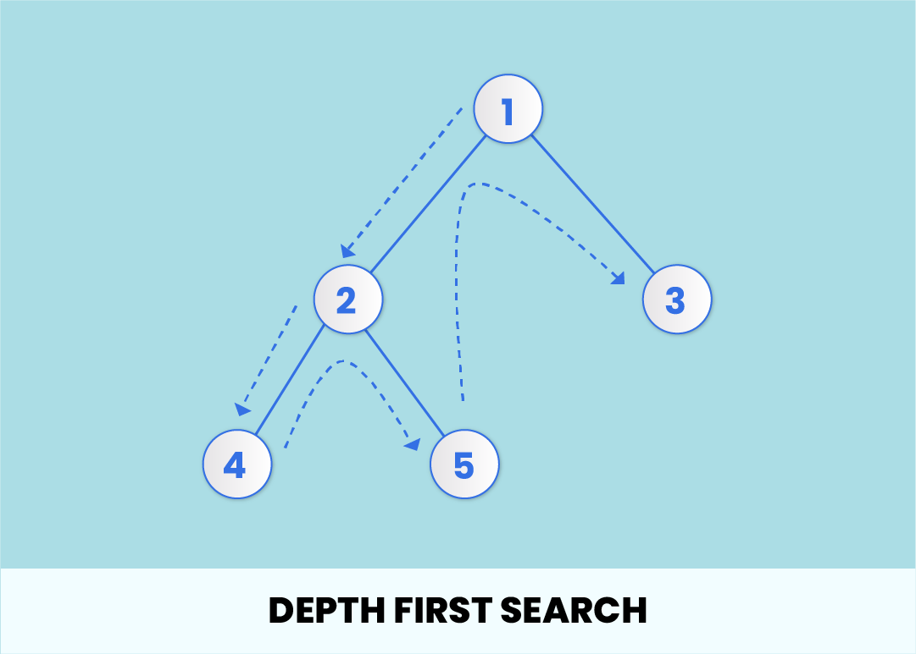
Basic Operations in a Graph

Slide 14
Basic Operations in a Graph
This algorithm traverses the nodes in a vertical fashion. It starts with the root node and traverses one adjacent node and all its child nodes before moving on to the next adjacent node.
Example - The algorithm will start with 1 and search all the nodes connected to 2 - 4 and 5, and then move to the next adjacent node to 1 i.e. 3. The order would be given as: 1 -> 2 -> 4 -> 5 -> 3.

Slide 15
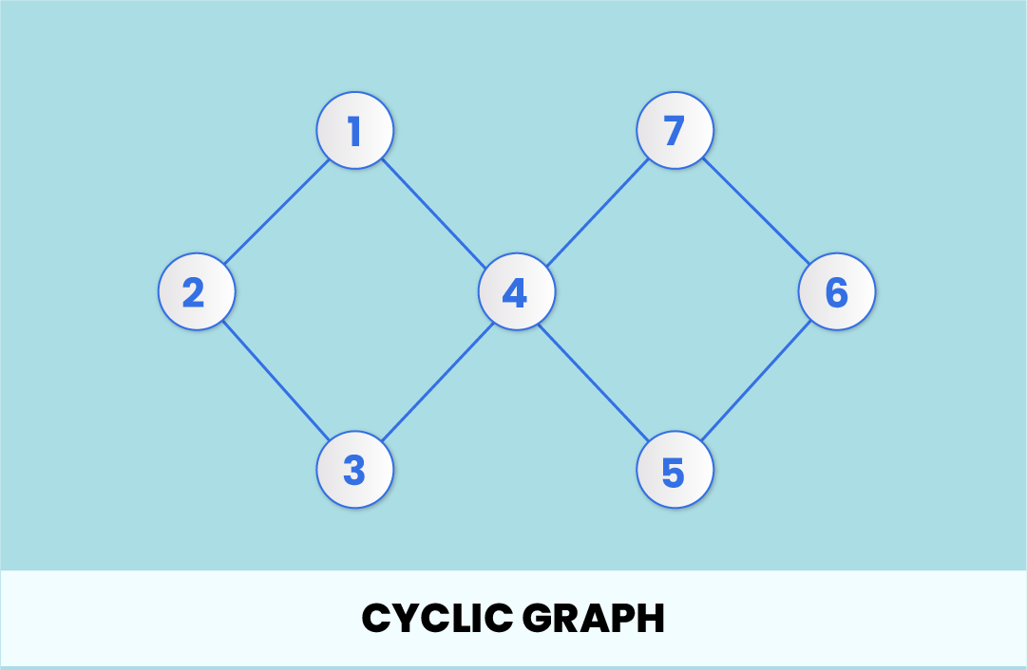
Graph Types

Slide 16
Graph Types
As the name suggests, the vertices and edges form a cycle in a cyclic graph. The number of vertices n in a cyclic graph will always be equal to or greater than 3 (n>=3), and the number of edges will also be 'n' for it to form a cycle.
Example - A graph G that consists of n vertices (n>=3) i.e. X1, X2, X3........Xn and edges (X1, X2), (X2, X3), (X3, X4)........(Xn, X1) will be a cyclic graph, since the last vertex Xn is also connected to X1.

Slide 17
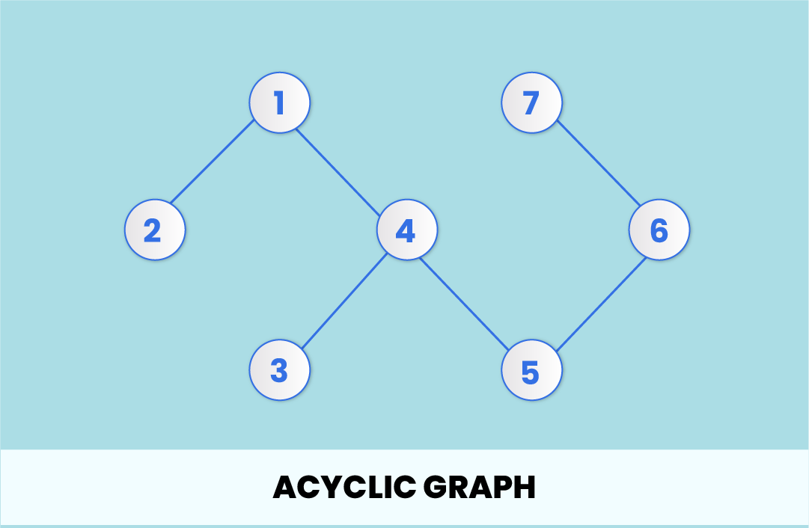
Graph Types

Slide 18
Graph Types
If there are no cycles present in a graph, it's an acyclic graph.
If we start traversing the graph from point 2, we wouldn't have a path to traverse all the vertices and come back to point 2.

Slide 19
Representation of Graph
There are two major ways to do that:
  Adjacency matrix (Sequential representation)
  Adjacency list (Linked list representation)

Slide 20
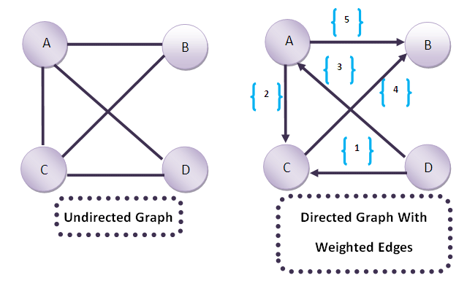
Representation of Graph
Adjacency matrix
An adjacency matrix is used to represent the mapping between vertices and edges of the graph.
It can represent the undirected graph, directed graph, weighted undirected, and weighted directed graph.

Slide 21
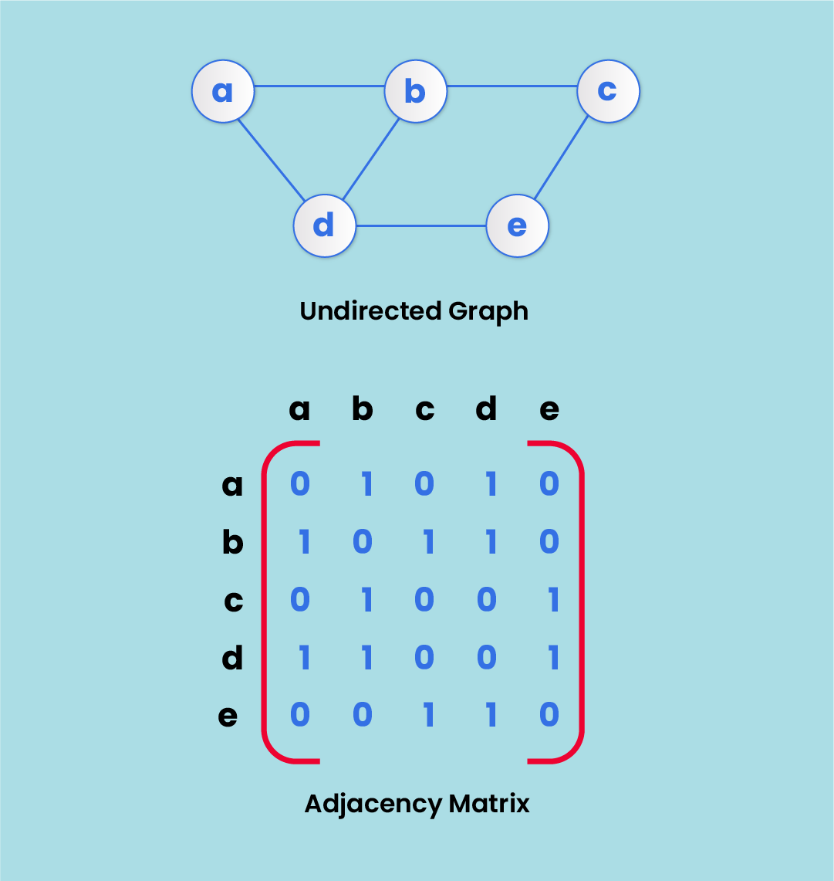
Representation of Graph

Slide 22
Representation of Graph
Adjacency list
Adjacency list uses linked lists to represent a graph.
For each node in a graph, there exists a linked list that stores the node value and a pointer to the next adjacent node.

Slide 23
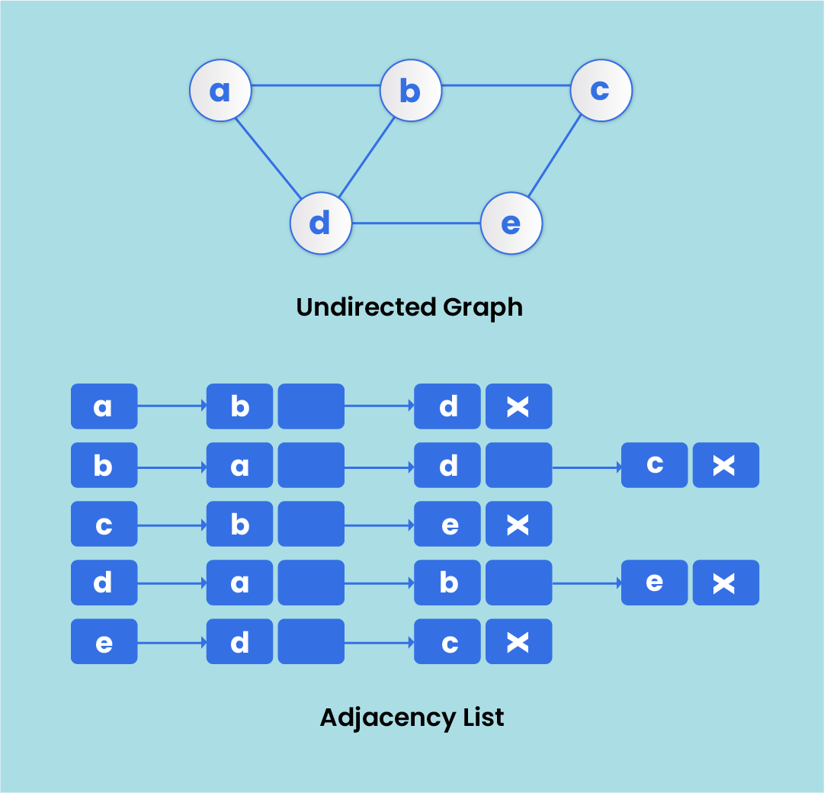
Representation of Graph

Slide 24

Example - Blockchain

Slide 25


